Slide 1
Cardiovascular System
Session 4
The Autonomic Nervous System
The structure and function of the ANS

Slide 2
The aim of this session is:
To introduce the structure and function of the autonomic nervous system and its role in the control of the cardiovascular system .

Slide 3
Learning outcomes:
By the end of the session and with appropriate self study you should be able to:
• Describe the critical anatomical features of the autonomic nervous system, such as the existence of ganglia, and division into pre- and post-ganglionic neurones.
Describe the key anatomical features of the sympathetic and parasympathetic branches of the autonomic nervous system, including where pre-ganglionic fibres leave the CNS, the location of ganglia and the relative length of the pre-and post-ganglionic fibres.
List the structures innervated by each of the sympathetic and parasympathetic systems, and in broad terms, the effect of the sympathetic or parasympathetic activity upon these structures.
Name the usual chemical transmitters at the synapses between pre- and post-ganglionic neurones in each of the sympathetic and parasympathetic branches, and the type of receptors upon the post-ganglionic cell body.

Slide 4
Name the usual chemical transmitter released from post-ganglionic neurones of the parasympathetic system, and state the class of receptor upon which it normally acts
Name the usual chemical transmitters released from post-ganglionic neurones of the sympathetic system and the types of receptor upon which it normally acts.
State in broad terms the distribution of different types of adrenoreceptor around the body.
State the action of the sympathetic nervous system on blood vessels in different organs.
State the action of the sympathetic and parasympathetic system upon heart rate and force of ventricular contraction.

Slide 5
The autonomic nervous system is an efferent system. Nervous activity flows out from the central nervous system to the tissues. It is mostly involved in the control of involuntary processes. The defining characteristic of the autonomic nervous system is that one nerve cell in the pathway is located entirely outside of the central nervous system. The cell bodies of these neurones are located in structures known as ganglia (sing. ganglion).
Pre-ganglionic fibres leave the CNS, and then synapse with post-ganglionic cell bodies in the ganglia. The fibres of these cells run to the innervated structures and form neuro effector junctions with effector cells. Transmission at both ganglionic synapses and neuro effector junctions is by the release of chemical messengers - neurotransmitters.
The autonomic nervous system is divided into two branches, distinguished primarily by the sites at which the pre-ganglionic fibres leave the central nervous system.

Slide 6
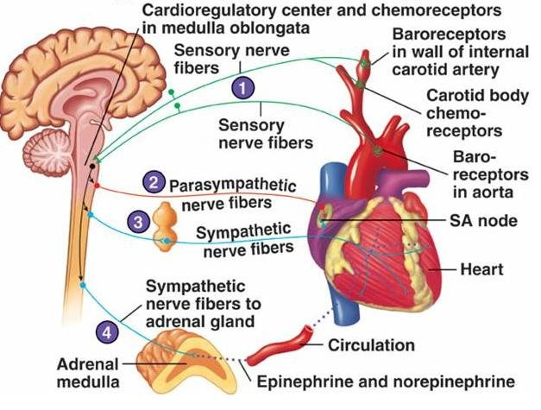

Slide 7
Pre-ganglionic fibres of the parasympathetic system leave the CNS either in the cranial nerves (i.e. directly from the brain) or from the sacral region - so called cranio-sacral outflow.
Generally speaking the ganglia of the parasympathetic system are located close to, or sometimes within the structures controlled by the systems. Pre-ganglionic fibres therefore tend to be long and post-ganglionic fibres short. There are however some ganglia in the neck and abdomen, located further away from the target organs.

Slide 8
Pre-ganglionic fibres of the sympathetic branch leave the CNS from the thoracic and lumbar regions - so called Thoraco-lumbar outflow. Synapses between pre - and post-ganglionic neurones are mostly located in ganglia close to the spinal cord (the 'sympathetic chain'), so pre-ganglionic fibres are short and post-ganglionic fibres long. Some ganglia are located in the neck and abdomen, and these have longer pre-ganglionic fibres.
Most organs in the body are innervated by the sympathetic nervous system, rather fewer by the parasympathetic. Some organs have both sympathetic and parasympathetic innervation which generally, but not invariably, have opposing actions.

Slide 9
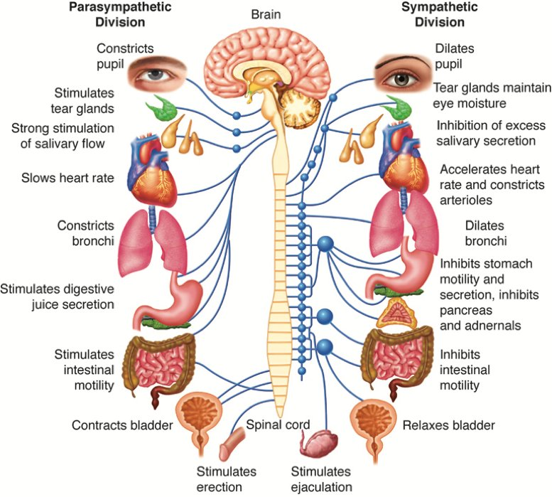

Slide 10
Chemical transmitters in the ANS
The pre-ganglionic fibres of both sympathetic and parasympathetic branches release the neuro transmitter acetylcholine. Like all chemical transmitters it acts upon a receptor on the ganglionic cell body. Receptors are categorised into types by their responses to different agonists and antagonists. The acetylcholine receptor on the post-ganglionic cell bodies is of the nicotinic type.
Most but not all post ganglionic parasympathetic fibres also release acetylcholine, which usually acts on a different type of receptor on the effector cell - the muscarinic sub type.

Slide 11
Most but not all post-ganglionic sympathetic fibres release noradrenaline. Different effector organs have difference receptor types for noradrenaline. There are two broad types -receptors, and -receptors, but each is sub-divided according to responses to different drugs. Much more information about the pharmacology of the autonomic nervous system will be provided in the 'Membranes and Receptors' module.
Broadly speaking -receptors are found on vascular smooth muscle. -receptors are found in the heart, smooth muscle of the airways of the lung, adipose tissue and some blood vessels particularly in skeletal muscle.

Slide 12
The sympathetic system also includes the adrenal medulla. Pre-ganglionic fibres run to the adrenal medulla which is made up of modified post-ganglionic cells, known as chromaffin cells which secrete adrenaline into the blood stream. Circulating adrenaline will also act upon receptors in the tissues, producing a more generalised effect.

Slide 13
The ANS and the CVS
The autonomic nervous system is intimately involved in the control of the cardiovascular system via its action upon both blood vessels and the heart.

Slide 14
Blood Vessels
The smooth muscle in the walls of arteries, arterioles and veins is innervated by the sympathetic branch of the autonomic nervous system. Except in specialised vessels, sympathetic activity causes constriction of arterioles - vasoconstriction. There is constant activity in the sympathetic nervous system the sympathetic vasomotor tone tending tomake arteriolar smooth muscle contract.
The tone varies from organ to organ, as does the magnitude of its effect. In skin, for example, vasomotor tone is high, so arterioles, pre-capillary sphincters and arterio-venous anastomosis are generally shut down. Variation in sympathetic outflow produce large changes in skin blood flow, usually for purposes ofthermoregulation

Slide 15
In skeletal muscles vasomotor tone is high at rest, but in exercise is antagonised both by
local release of vasodilator metabolites and by specialised vasodilator nervous activity.
In the gut vasomotor activity is high until a meal is consumed, when it is antagonised by
various vasodilator substances produced in gut tissue.
The circulation to the brain on the other hand is virtually unaffected by sympathetic activity.
The interplay between sympathetic vasoconstrictor tone and the action of vasodilator
substances is therefore the principal means by which the distribution of flow around the
cardiovascular system is controlled.
Sympathetic outflow to blood vessels is controlled from the hindbrain - via the 'vasomotor' centres in the medulla oblongata.

Slide 16
Sympathetic activity also produces veno-constriction which is contraction of smooth muscle in the walls of veins. This tends to increase venous pressure and force more blood back towards the heart.
The parasympathetic branch of the ANS acts only on specialised blood vessels, though itsstimulating action on organs such as the gut is associated with the release of mediatorswhich may produce dramatic vasodilatation.

Slide 17
The heart
Heart rate is affected by both the parasympathetic and sympathetic branches of the ANS.
Parasympathetic activity tends to slow the heart rate. In the absence of any autonomic activity the heart rate is about 100 bpm, so the normal resting heart rate of about 60 is produced by a constant parasympathetic 'tone'. Initially increases in heart rate are brought about by reducing parasympathetic activity.
Sympathetic activity increases heart rate. Rises in heart rate beyond 100 bpm are brought about by sympathetic stimulation. Both parasympathetic and sympathetic outflow to the heartis controlled by centres in the medulla oblongata which themselves receive information from sensory receptors detecting blood pressure ('baroreceptors') and higher centres in the CNS.
The force of contraction of heart muscle ('contractility' - see next session) is increased by sympathetic activity

Slide 18
The action of the parasympathetic system on heart rate is mediated via acetylcholine acting on muscarinic receptors.
The action of the sympathetic system on heart rate and contractility is mediated via Noradrenaline acting on β1 receptors. Adrenaline from the adrenal medulla also acts on the heart. The autonomic nervous system therefore provides the central nervous centresresponsible for controlling the CVS with the means to affect the Total Peripheral Resistanceand distribution of blood flow, and the cardiac output.

Slide 19
Thanks

